Slide 1
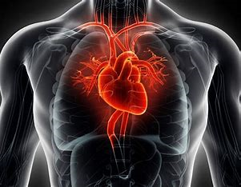
Heart disease Diagnostic analysis
Data analysis using python and MS PowerBI
Project Presented by
Nikita Jagtap

Slide 2
PROJECT DETAIL
Project Name | Heart Disease Diagnostic Analysis
Technology | Data Analytic
Domain | Healthcare
Project Difficulty level | Intermediate
Programming language used | Python
Tools used | Jupyter Notebook, MS- PowerBI.
Over the past few weeks, I conducted an in-depth analysis of a heart disease dataset, utilizing Python (Pandas, Matplotlib, Seaborn) to explore 1025 records with 14 features. The objective of this analysis was to identify key factors associated with heart disease and develop a predictive model using logistic regression. Through meticulous data cleaning and preparation, I ensured the accuracy and reliability of the dataset.
Python’s powerful libraries facilitated the creation of detailed visualizations, which highlighted significant patterns and trends in heart disease risk factors, such as chest pain type, maximum heart rate, and ST depression. The logistic regression model, developed through rigorous training and testing, achieved an accuracy of approximately 85.7%. The project’s findings are instrumental in guiding future research and improving decision-making in healthcare.

Slide 3
PROBLEM STATEMENT
Health is real wealth in the pandemic time we all realized the brute effects of covid-19 on all irrespective of any status. You are required to analyze this health and medical data for better future preparation.
To perform a comprehensive exploratory data analysis (EDA) on a heart disease dataset to identify key factors associated with heart disease.
To examine the distribution and correlation of various features such as age, gender, chest pain type, and ST depression with the presence of heart disease.
To visualize patterns and trends in the dataset, focusing on understanding the relationship between clinical features and heart disease outcomes.
To provide insights into which features may be critical indicators of heart disease risk, assisting healthcare professionals in better diagnosing and managing patients.

Slide 4
DATASET DETAIL
The dataset consists of approximately 1025 Records and 14 Key Features(Columns).
age | Age of the patient
sex | Sex of the patient (likely binary encoded)(1 for Male and 0 for Female)
cp | Chest pain type (4 values)( 0 : 'Typical angina', 1: 'Atypical angina', 2: 'Non-anginal pain', 3: ‘Asymptomatic’)
trestbps | Resting blood pressure
chol | Serum cholesterol
fbs | Fasting blood sugar(> 120 mg/dl, 1 = true; 0 = false)
restecg | Resting electrocardiographic results (values 0,1,2)(0 : 'Normal', 1: 'Abnormal', 2: 'Ventricular hypertrophy’)
thalach | Maximum heart rate achieved
exang | Exercise-induced angina (1 = yes; 0 = no)
oldpeak | ST depression induced by exercise relative to rest
slope | The slope of the peak exercise ST segment (0 : 'Upsloping', 1: 'Flat', 2: 'Downsloping’)
ca | Number of major vessels colored by fluoroscopy (0-4) 0 : 'Mild', 1: 'Moderate', 2: 'Mild Severe',3: 'Moderate Severe', 4: 'Extreme Severe’
thal | Thalassemia (a blood disorder) 0 = normal; 1 = fixed defect; 2 = reversible defect;3=Extra defect
target | 0 for not heart disease patient and 1 for heart disease patient

Slide 5
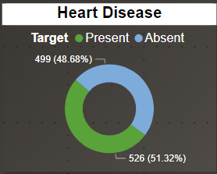
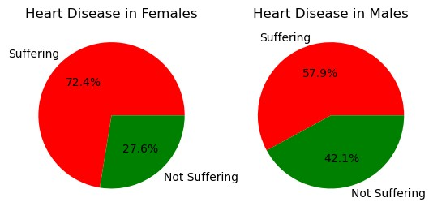
INSIGHTS FROM GRAPHS
About 51% of People is suffering from Heart Disease
About 72 % of Female is suffering from Heart Disease while 58% of Male is suffering from Heart Diseases.

Slide 6
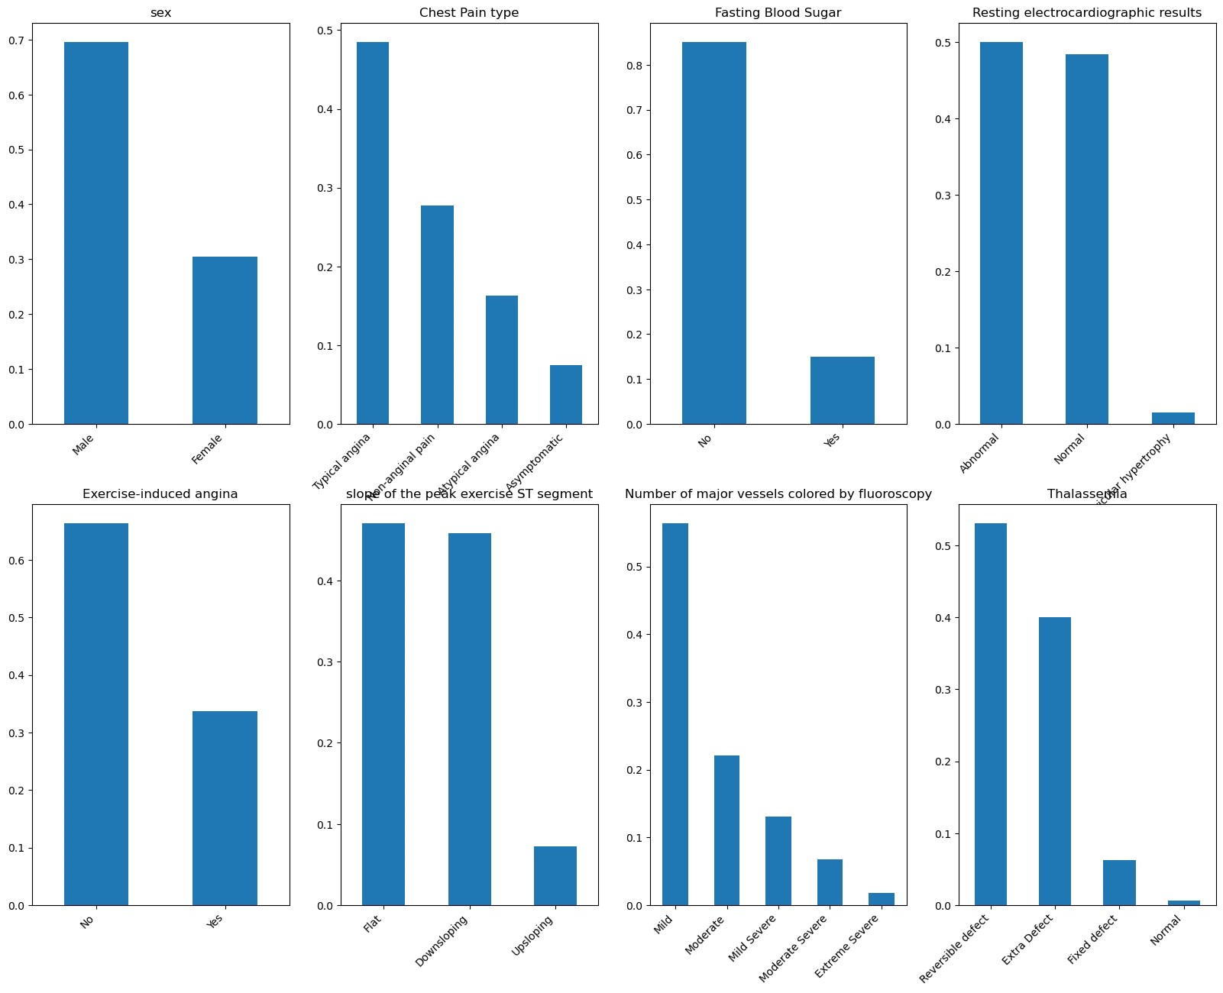
It can be inferred from above bar plot that:
70% in the dataset are Male.
50% in the dataset is Typical angina chest pain.
85% in the dataset have no fasting blood sugar.
almost same value is for normal and abnormal resting electrocardiographic results.
65% in the dataset are not Exercise induced angina.
downsloping and flat slope of the peak excercise ST segment are slightly difference.
60% in the dataset have Mild number of major vessels colored by fluoroscopy.
Reversible defect Thalassemia have 55% of the dataset.

Slide 7
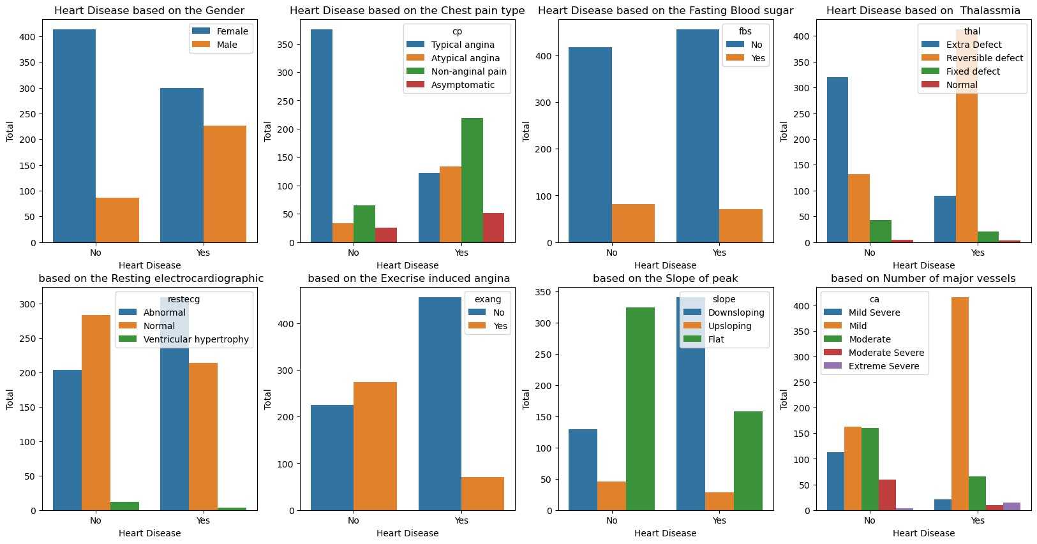
Males are more represented and have a higher prevalence of heart disease than Females.
People with typical angina (cp=0) are less likely to have heart disease, while those with asymptomatic chest pain (cp=3) are more likely to have it.
Individuals with a thalassemia value of Extra Defect and Reversible defect are more likely to have heart disease compared to those with a thalassemia value of Fixed defect and normal.
People with normal resting ECG results (restecg=0) are less likely to have heart disease, while those with ST-T wave abnormality (restecg=1) are more likely to have it.
People without exercise-induced angina (exang=0) are more likely to have heart disease compared to those with it (exang=1).
Individuals with a flat slope (slope=2) are more likely to have heart disease, while those with an upsloping segment (slope=0) are less likely to have it.
Most people with heart disease have 0 or 1 major vessel affected.

Slide 8
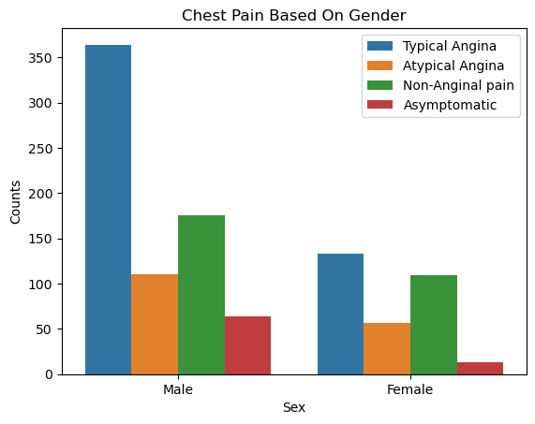
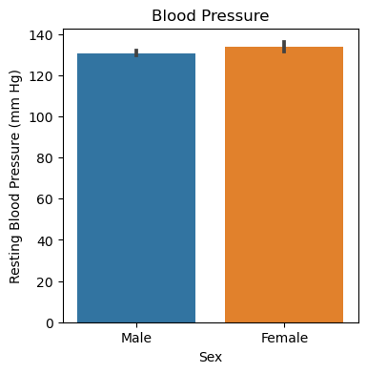
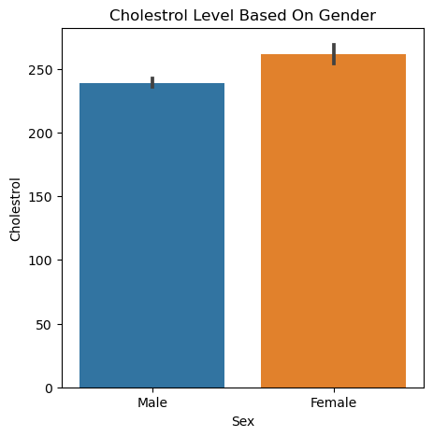
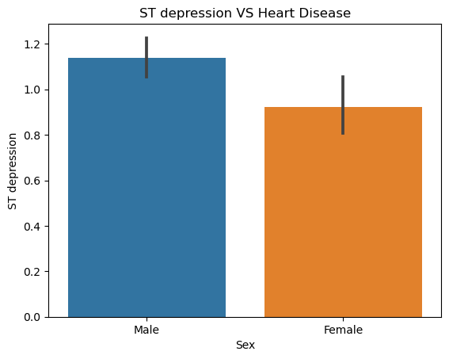
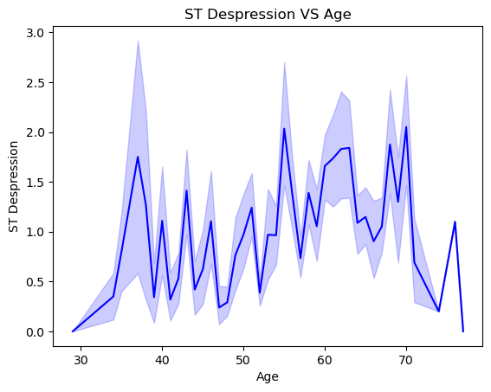
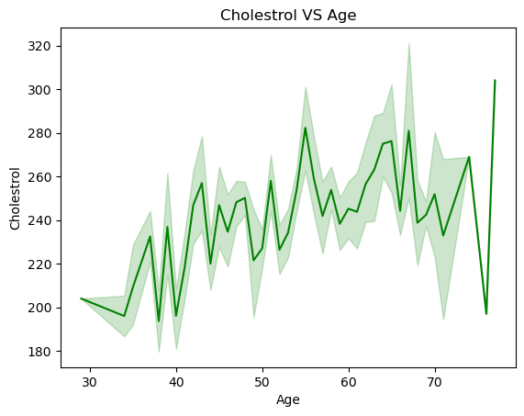
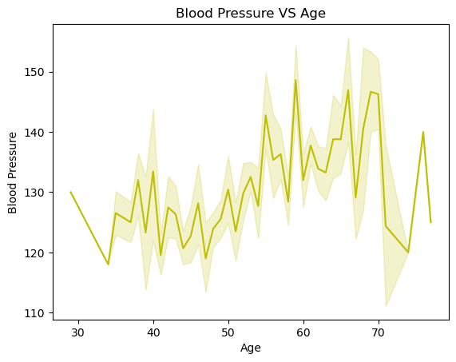
Males are more prone to all types of chest pain, especially typical angina.
Female Blood Pressure is slightly high than Male.
Cholestrol level of Female is inch of high than Males.
Males are prone to ST depression as compare to females
ST depression levels fluctuate widely across different ages, with noticeable peaks around the ages of 40, 50, and 60
Cholestrol level Increases from age of 40 to 70.
Blood Pressure increases from age 50 to 70.

Slide 9
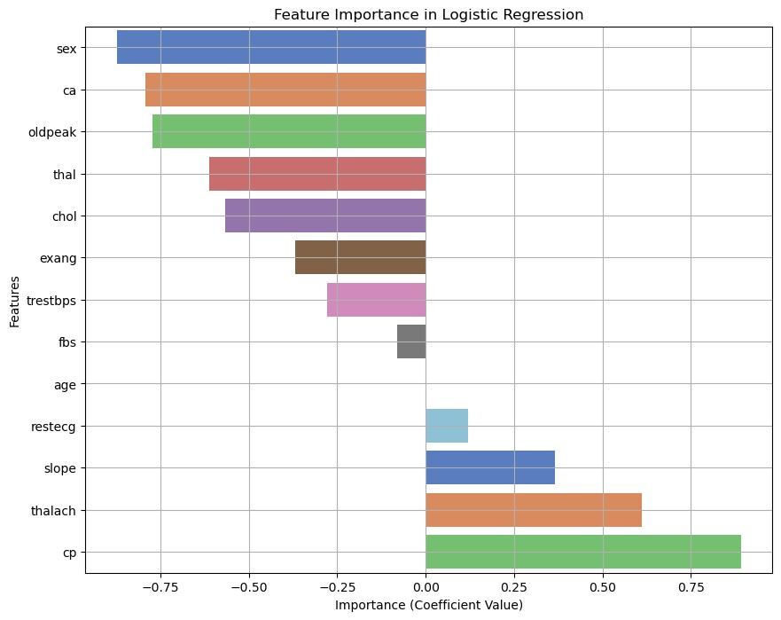
Features such as cp (chest pain type), thalach (maximum heart rate), exang (exercise-induced angina), and oldpeak (ST depression) have the highest coefficients, indicating their strong influence on the prediction of heart disease.

Slide 10
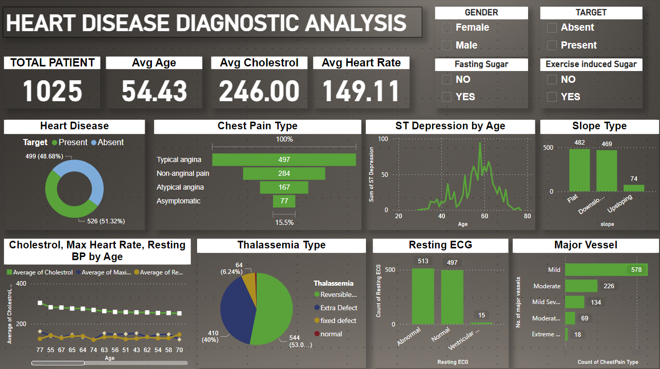
DASHBOARD

Slide 11
OVERALL INSIGHTS
Males have a higher prevalence of heart disease compared to females.
Typical angina is less associated with heart disease, while asymptomatic pain is more associated.
Features like chest pain type, maximum heart rate, ST depression, and exercise-induced angina are strongly correlated with heart disease.
The logistic regression model achieved an accuracy of approximately 85.7%.
Chest pain type, maximum heart rate, exercise-induced angina, and ST depression have the highest coefficients, highlighting their strong influence on heart disease prediction

